Slide 1
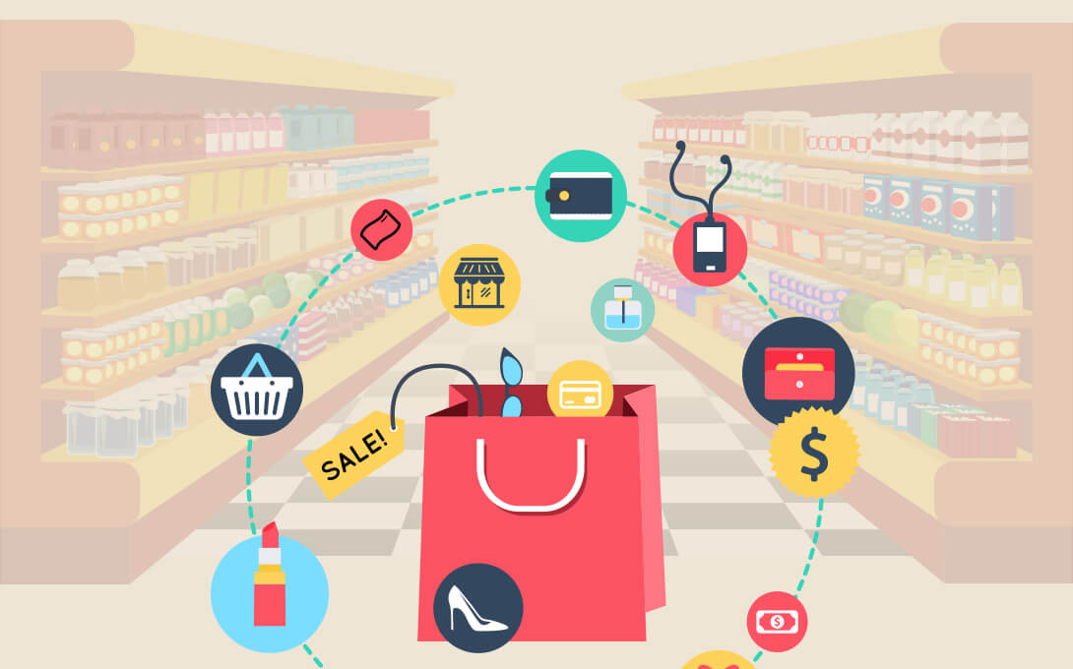
Chilin Tang Data & Analytics Digitas Singapore
Market Basket Analysis
Finding associations between items in a vast universe
1

Slide 2
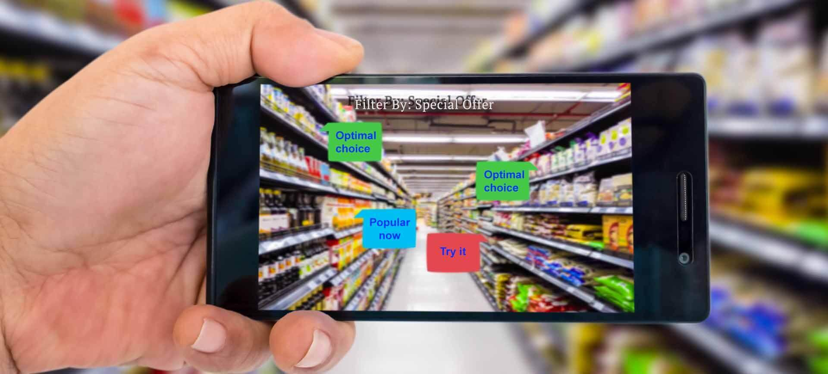
Chilin Tang Data & Analytics Digitas
Data Analytics for Customer Development
Market Basket Analysis
1

Slide 3
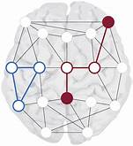
What is Market Basket Analysis (MBA)
It finds associations between activities in consumer behaviour, such as:
Different items in shopping carts
Marketing touch points leading to conversions
Search key phrases leading to product discovery
MBA is also known as association rule discovery or affinity analysis

Slide 4
Why Market Basket Analysis?
Business scenario
Each customer purchases different set of products, different quantities and at different times
Consumers responding to finite set of marketing stimuli, in different sequences and at different times, but leading to same conversion action
DECA Share of Search: Consumers having common search term but leading to / from other terms in online search sequence
The challenge for DECA
How to visualize most frequent pathways in Search history, leading users to the brand or product?
The answer
What associated searches happen together?

Slide 5
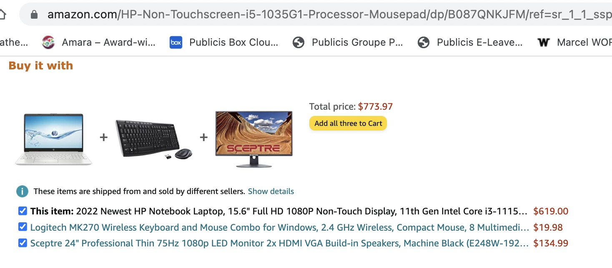
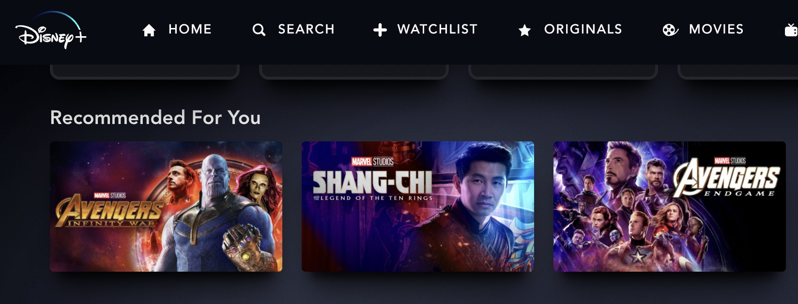
Common Use-Cases for Market Basket Analysis
Recommended items for eCommerce
Recommended playlists

Slide 6
General applications of Market Basket Analysis
Sometimes known as a system for “Recommendation” or “You may also consider these products”, MBA promotes cross and up-sell by associating related products together
In a major store promotion, it can evaluate if loss leaders are driving customers to buy other products, and what these products are

Slide 7
General applications of Market Basket Analysis
For major brands having several related products, MBA can ascertain if consumers are buying products from same brand.
Or, buying products from different brands due to deficiencies not known to brand owner. Such as, consumers buying audio speakers of different brand from audio system, due to technical issues
For tourism promotions targeting a specific segment, MBA can analyse ”basket” of desired experiences tourists seek when they travel. So that a similar “basket” can be offered to them on arrival

Slide 8
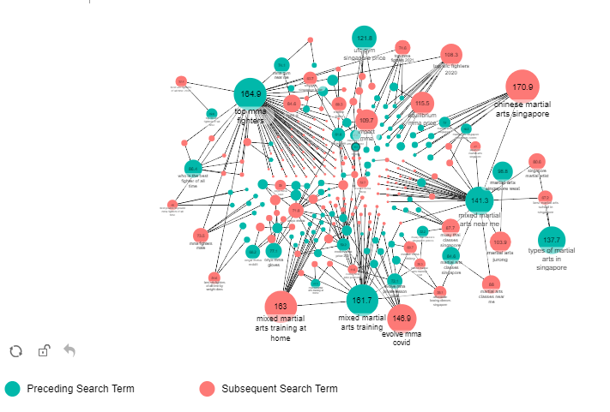
How Market Basket results are visualised
As a network diagram demonstrating what’s associated and what’s not. Numbers in bubbles represent Lift

Slide 9

Simple methodology behind MBA
Names of customers visiting bridal store as a pair on 6 April 2022 | Names of customers visiting jewellery store as a pair on 6 April 2022
1 | Ben | Jessie
2 | John | Judy
3 | Peter | Mary
4 | Ben | Jessie
5 | John | Miriam
6 | Peter | William
7 | Ben | Jessie
Who’s likely to be in a relationship?

Slide 10
Applying MBA statistical concept to bridal store
Names of customers visiting jewellery store as a pair on 6 April 2022
 |  | No of Occurrences
John | Judy | 1/7
Peter | Mary | 1/7
John | Miriam | 1/7
Peter | William | 1/7
Ben | Jessie | 3/7
Number of times Ben visited = 3/7 = 43% (Support)
Number of time Jessie visited = 3/7 = 43% (Expected Confidence)
Number of times Jessie is seen
when Ben visits = 3/3 = 100% (Confidence)
In statistics, we say there’s a LIFT when Confidence ÷ Expected Confidence > 1
With 100% ÷ 43% = there’s a 2.32 LIFT that Ben & Jessie are likely to be in a relationship

Slide 11

Preparing Data for MBA
Accepts many data types - categorical, numeric and text, except binary
Dataset should be in transactional structure (item 1, item 2, item 3, etc)

Slide 12
How MBA can improve customer experiences
If brands are aware of weaknesses behind their product or service, MBA can see if and how consumers are getting workarounds
Recommendations to consumers driven by MBA should be targeted on consumer interests and behavior, rather than as spam to all customers.

Slide 13
Statistical methodology behind MBA
Items are the objects or actions that we are identifying associations with
Transactions are groups of items co-occuring together (i.e. "Basket")
Left / Right Hand Rule is the likelihood a person, having taken action on left hand side (LHS = "flour + sugar"), will be interested in item on the right hand side (RHS = "eggs")

Slide 14














Basics of MBA - Support
Support is the probability that two item sets occur together.
A B _{C}
A C _{D} B C _{D} A D _{E} B C _{E}
Support (A → B) =
transactions containing every item in A and B all transactions
We should identify rules that have a high support, as these will be applicable to a large number of transactions

Slide 15




Basics of MBA - Confidence
Confidence is the conditional probability of a transaction containing item set B given that it contain item set A.
A B _{C}
A C _{D}
B C _{D} A D _{E}
B C _{E}
Confidence (A → B) =
transactions containing every item in A and B transactions containing the items in A

Slide 16




Basics of MBA – Expected Confidence
A B _{C}
A C _{D}
B C _{D} A D _{E}
B C _{E}
Expected Confidence is the probability of one or several items occurring within entire dataset
Rule Support Confidence Expected Confidence
A ⇒D | 2/5 | 2/3 | 3/5 (Prob of D)
C ⇒A | 2/5 | 2/4 | 3/5 (Prob of A)
A ⇒C | 2/5 | 2/3 | 4/5 (Prob of C)
B & C ⇒D | 1/5 | 1/3 | 3/5 (Prob of D)

Slide 17
Basics of MBA - Lift
The ratio by which by the confidence of a rule exceeds expected confidence.
The higher the ratio (greater than 1), the more likely items in basket are closely associated (correlation)
If lift = 1 it indicates that the items are independent (i.e. not more likely to occur in basket)
If lift < 1, then items have less likely to occur in basket compared to normal circumstances of dataset (negative correlation)
11

Slide 18
Basics of MBA - Lift
A B _{C}
A C _{D}
B C _{D} A D _{E}
B C _{E}
Rule
Support
Confidence
Expected Confidence
Lift
A ⇒D C ⇒A A ⇒C
B & C ⇒D
2/5 | 2/3 | 3/5 (Prob of D) | 1.11
2/5 | 2/4 | 3/5 (Prob of A) | 0.83
2/5 | 2/3 | 4/5 (Prob of C) | 0.83
1/5 | 1/3 | 3/5 (Prob of D) | 0.55

Slide 19






Example in calculating Support, Confidence & Lift
Checking Account
No Yes
500 3500
1000 5000
No
4,000
Savings Account
Yes
6,000
10,000
Support(Savings & Checking) = 50% Confidence(Savings & Checking / Savings) = 83% Expected Confidence(Checking / All Accounts) = 85% Lift(Savings & Checking) = 0.83/0.85 < 1

Slide 20
MBA Use Case - Google Search Associations
Through DECA, we are able to find associated user searches on Google
From sequences of user searches, we can find out:
Search patterns leading users to a given brand / product or away to competitors' offerings
What topics do users search for, around given subject matter
Which sequence of searches have shorter route to conversion?

Slide 21
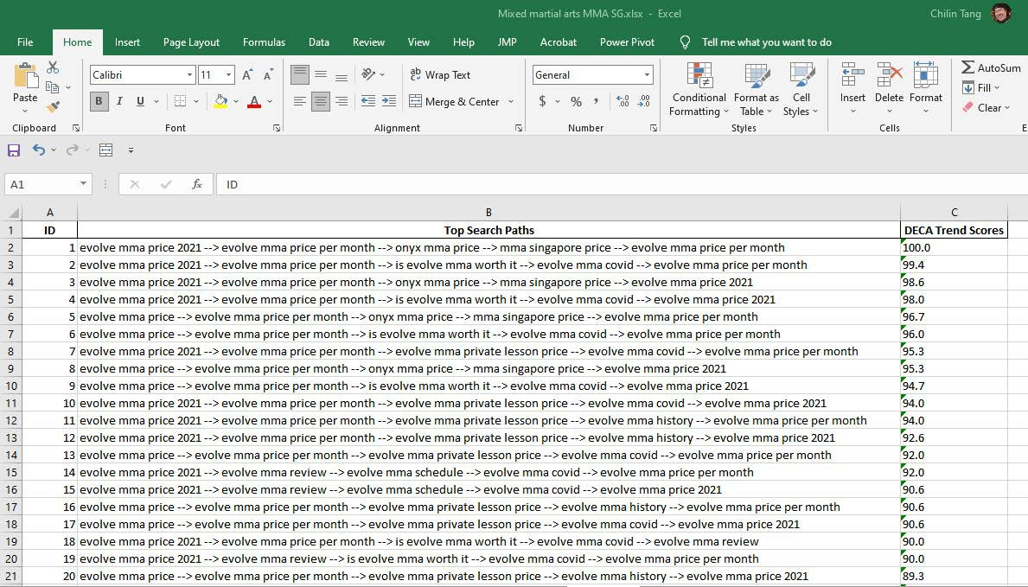
MBA Step 1: Getting data in Power BI
1.1 Examine DECA data on "Mixed Martial Arts" searches

Slide 22
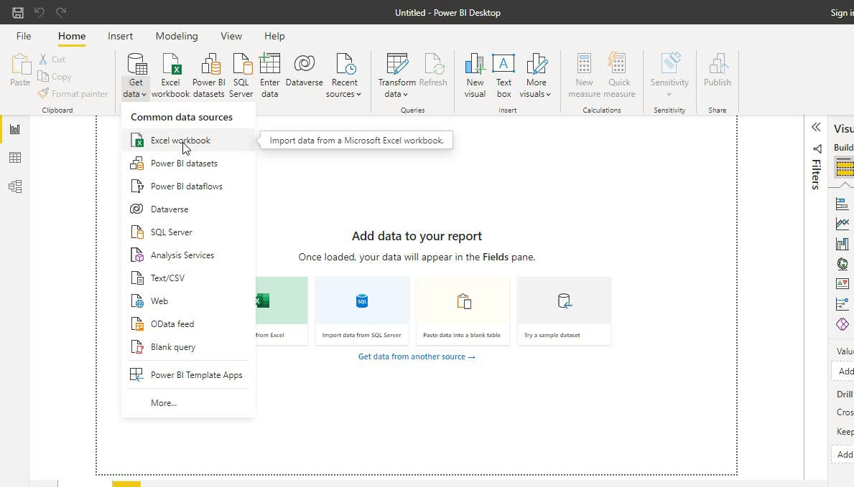
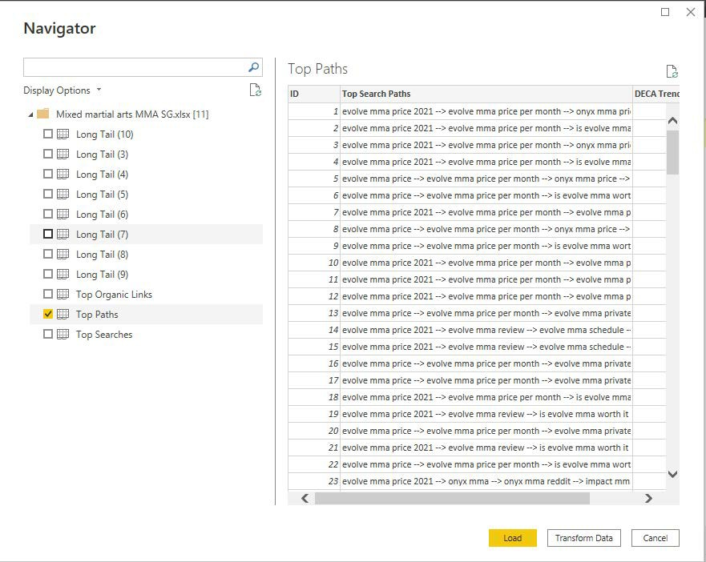
MBA Step 1: Getting data in Power BI
1.2 Pulling DECA dataset

Slide 23
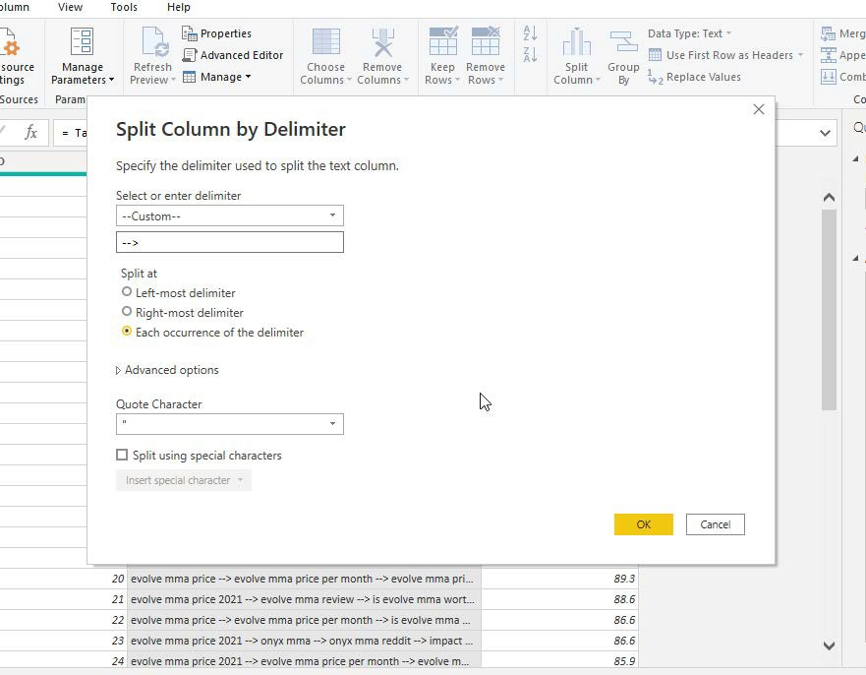
MBA Step 1: Getting data in Power BI
1.3 Splitting search terms by delimiter

Slide 24
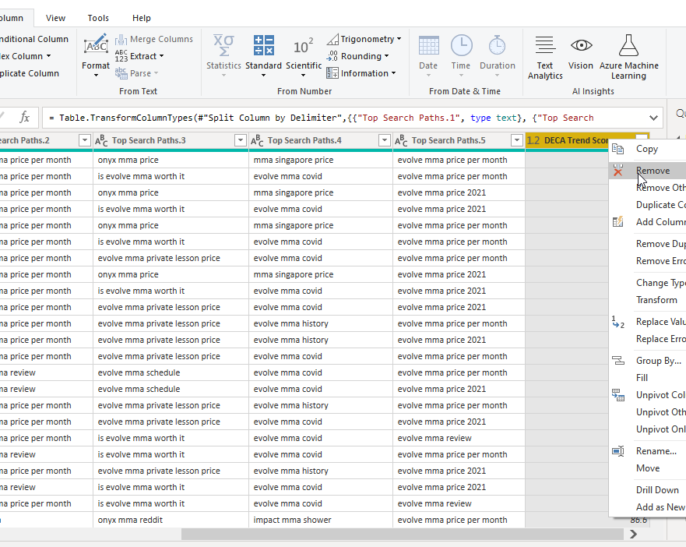
MBA Step 1: Getting data in Power BI
1.4 Remove DECA Scores column

Slide 25
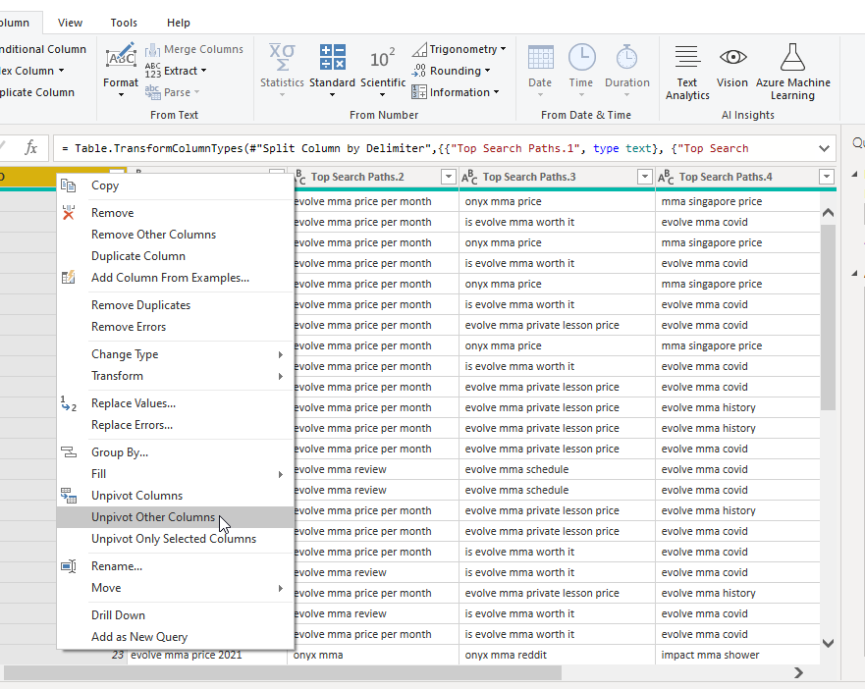
MBA Step 1: Preparing the dataset
1.5 Click on ID column and unpivot other columns

Slide 26
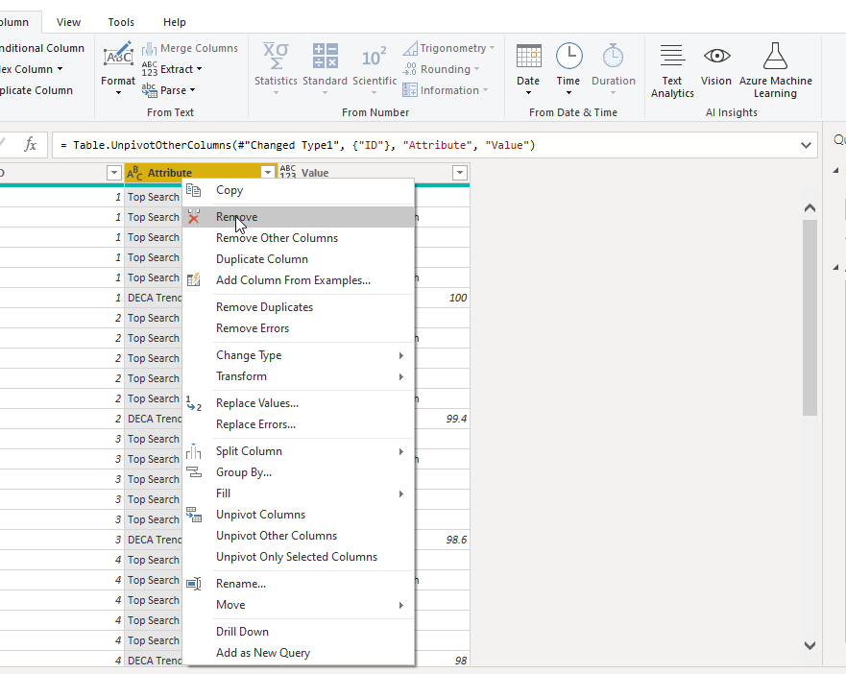
MBA Step 1: Preparing the dataset
1.6 Remove the “Attribute” column

Slide 27
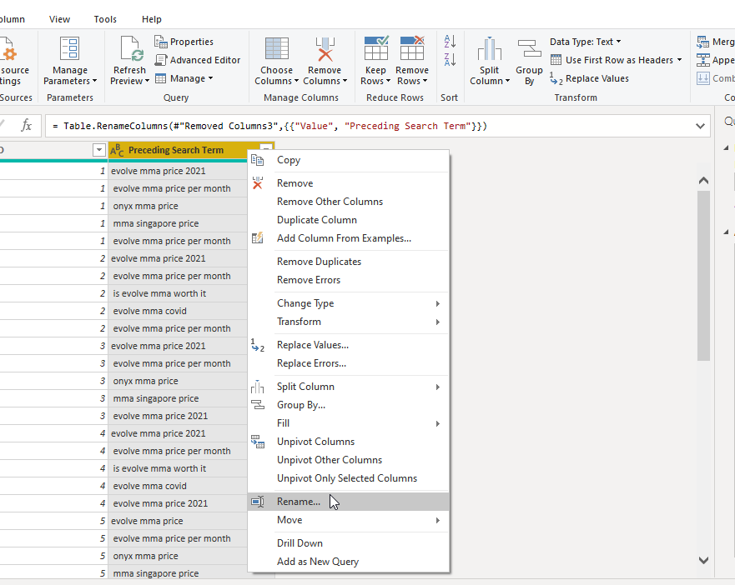
MBA Step 1: Preparing the dataset
1.7 Rename “Values” to “Preceding Search Term”
Click on Close & Apply to go back to report

Slide 28
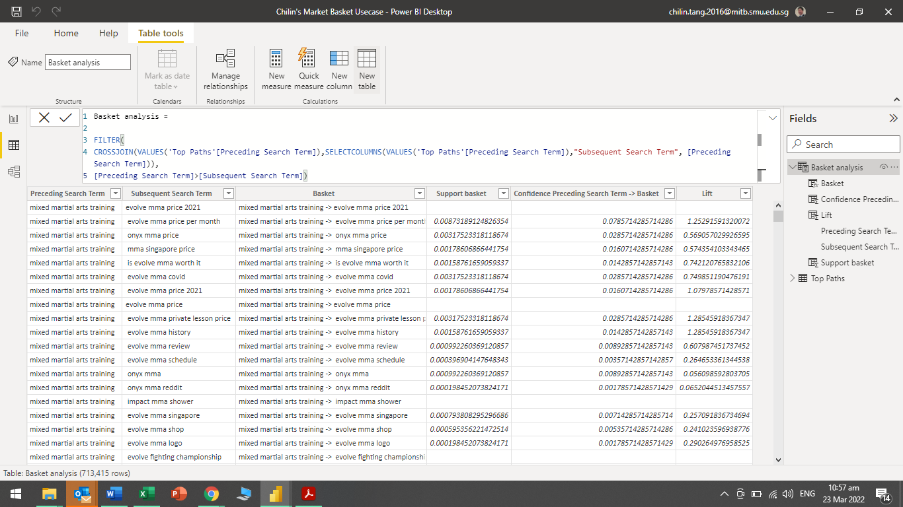
MBA Step 2: Building Associated Rules
2.1 Create on new table
Enter code below to create the “Subsequent Search Term” column, with all terms associated with “Preceding Search Term”
Basket analysis =
FILTER(
CROSSJOIN(VALUES('Top Paths'[Preceding Search Term]),SELECTCOLUMNS(VALUES('Top Paths'[Preceding Search Term]),"Subsequent Search Term", [Preceding Search Term])),
[Preceding Search Term]>[Subsequent Search Term])

Slide 29
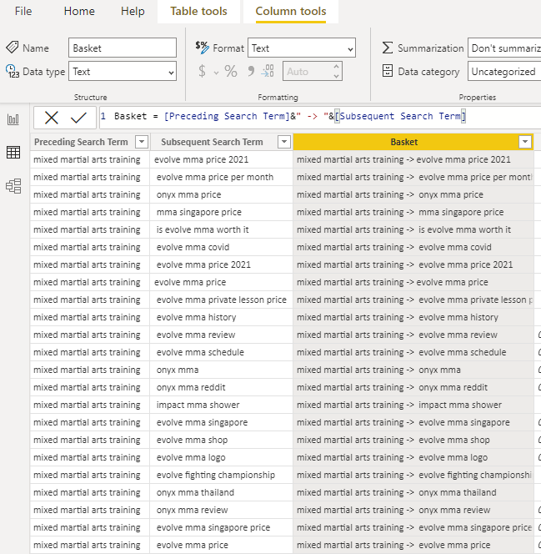
MBA Step 2: Building the Basket column
2.2 Click on “New Column”, enter code into panel
Basket = [Preceding Search Term]&" -> "&[Subsequent Search Term]

Slide 30
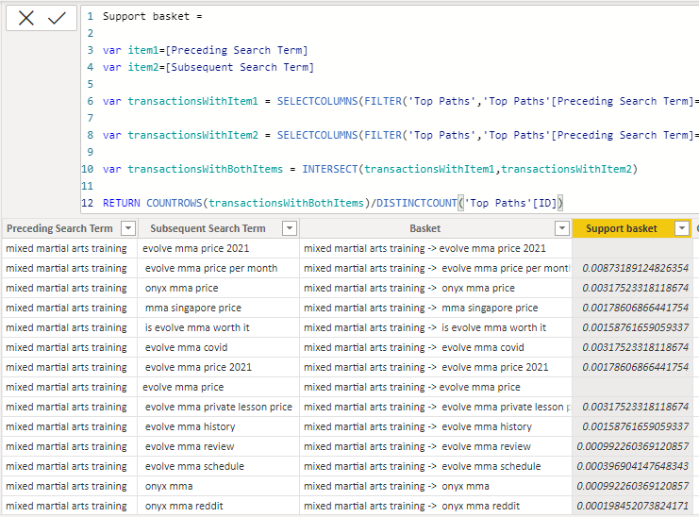
MBA Step 2: Building the Support column
2.3 Click on “New Column”, enter code into panel
Support basket =
var item1=[Preceding Search Term]
var item2=[Subsequent Search Term]
var transactionsWithItem1 = SELECTCOLUMNS(FILTER('Top Paths','Top Paths'[Preceding Search Term]=item1),"Index",'Top Paths'[Index])
var transactionsWithItem2 = SELECTCOLUMNS(FILTER('Top Paths','Top Paths'[Preceding Search Term]=item2),"Index",'Top Paths'[Index])
var transactionsWithBothItems = INTERSECT(transactionsWithItem1,transactionsWithItem2)
RETURN COUNTROWS(transactionsWithBothItems)/DISTINCTCOUNT('Top Paths'[Index])

Slide 31
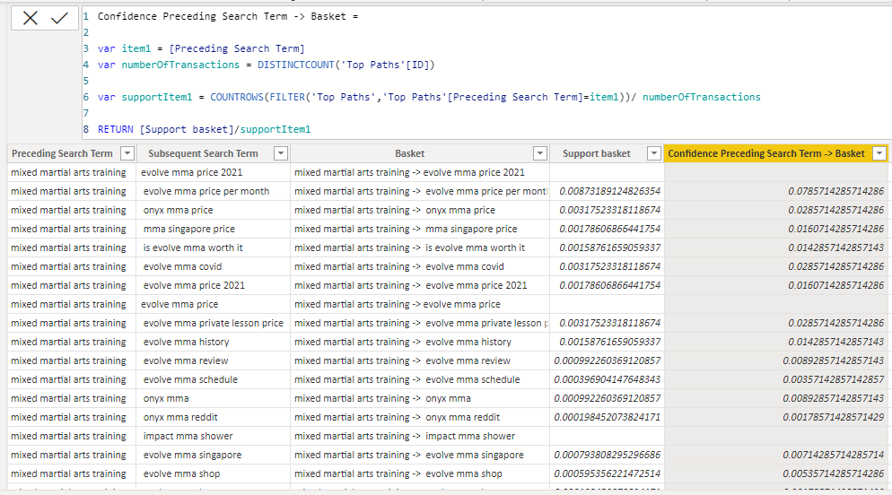
MBA Step 2: Building the Confidence column
2.4 Click on “New Column”, enter code into panel
Confidence Item 1 -> Basket =
var item1 = [Preceding Search Term]
var numberOfTransactions = DISTINCTCOUNT('Top Paths'[Index])
var supportItem1 = COUNTROWS(FILTER('Top Paths','Top Paths'[Preceding Search Term]=item1))/ numberOfTransactions
RETURN [Support basket]/supportItem1

Slide 32
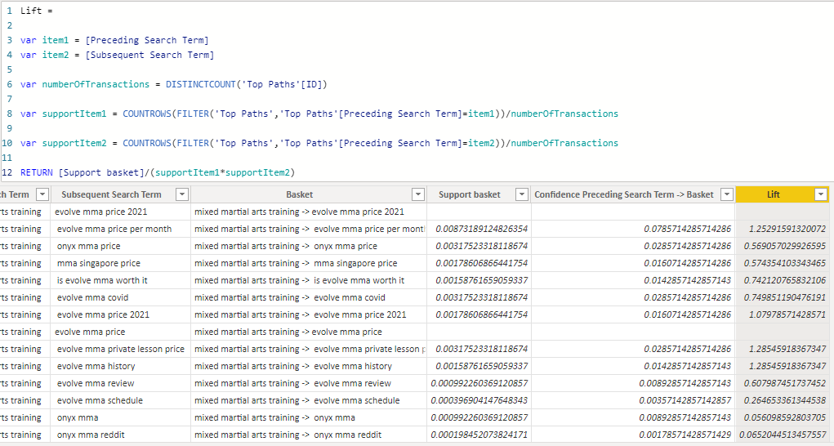
MBA Step 2: Building the Lift column
2.5 Click on “New Column”, enter code into panel
Lift =
var item1 = [Preceding Search Term]
var item2 = [Subsequent Search Term]
var numberOfTransactions = DISTINCTCOUNT('Top Paths'[Index])
var supportItem1 = COUNTROWS(FILTER('Top Paths','Top Paths'[Preceding Search Term]=item1))/numberOfTransactions
var supportItem2 = COUNTROWS(FILTER('Top Paths','Top Paths'[Preceding Search Term]=item2))/numberOfTransactions
RETURN [Support basket]/(supportItem1*supportItem2)

Slide 33
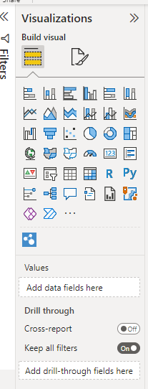
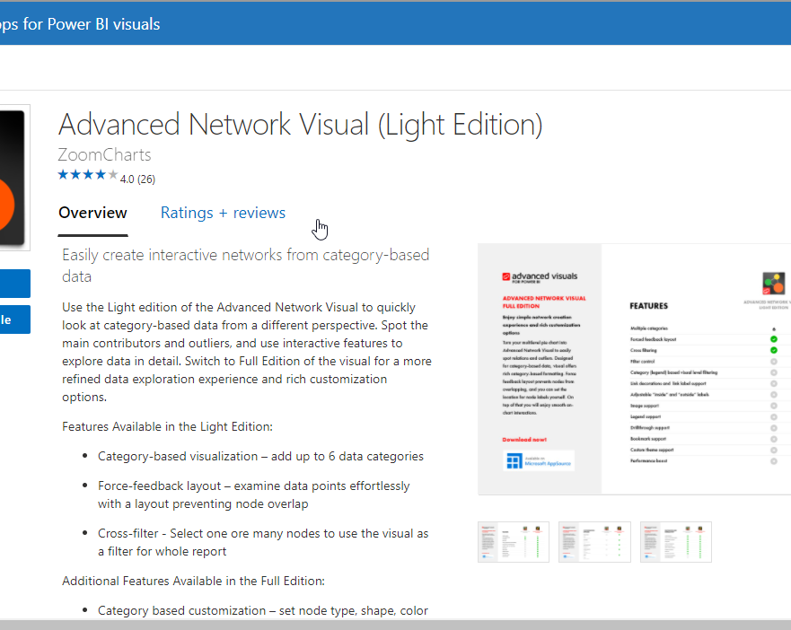
MBA Step 3: Visualisation
3.1 Going back to report table, add Advanced Network Visual

Slide 34
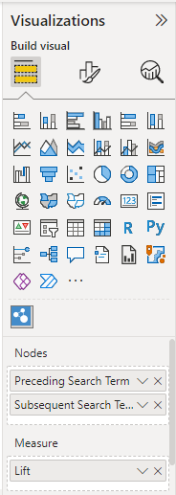
MBA Step 3: Visualisation
3.2 Once Advance Network visual is added, drag “Preceding Search Term” and “Subsequent Search Term” to Nodes. And “Lift” to Measure.

Slide 35
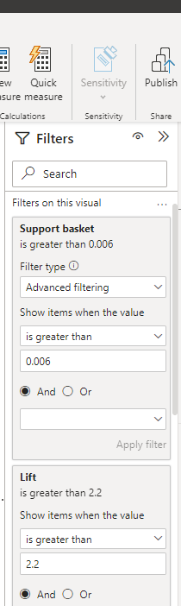
MBA Step 3: Visualisation
3.3 The network diagram between Preceding and Subsequent Search Terms is now created.
Numbers in bubbles indicate Lift.
To keep the diagram manageable, filters for Support and Lift can be adjusted

